Slide 1


Slide 2
What are Core Values?
Metro Plastics created Core Values that will provide each employee with a vision, build trust among co-workers, and support the ongoing, ever-changing climate with our customers. Why the core values? They are the fundamental beliefs of our organization. These guiding principles dictate behavior and can help people understand the difference between right and wrong. By creating an unwavering guide, core values also help organizations determine if they are on the right path and fulfilling, our organizations goals.

Slide 3


Slide 4
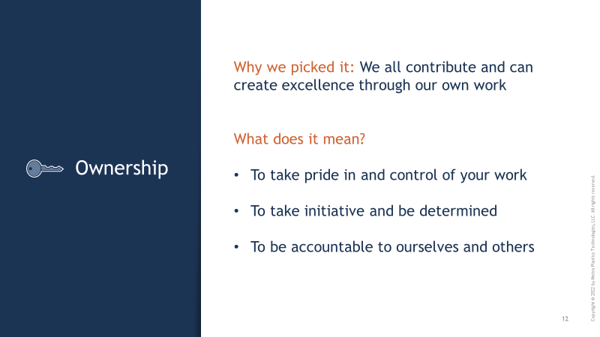

Slide 5
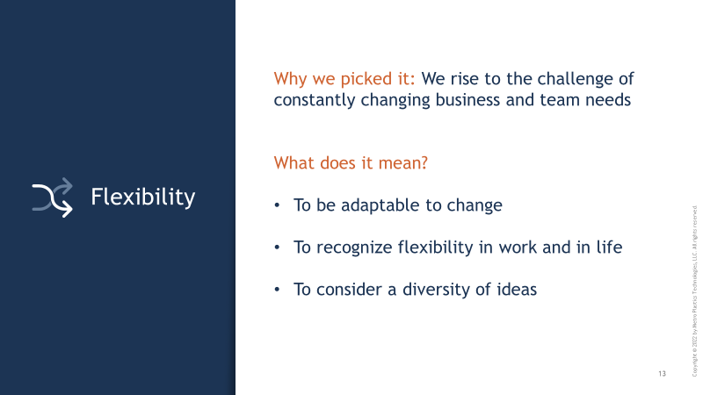

Slide 6
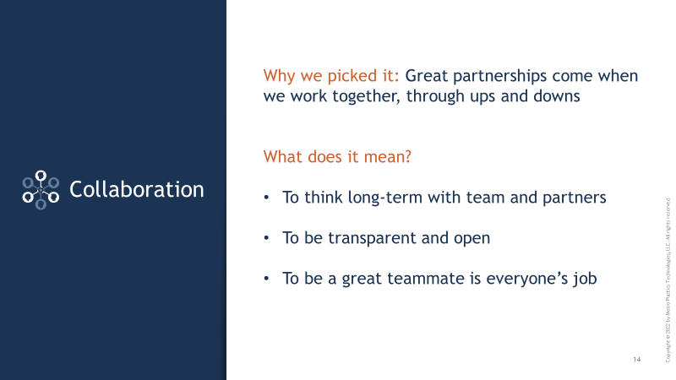

Slide 7


