Slide 1

Metro Plastics Technologies
Internal Auditing Class
ISO 9001:2015

Slide 2
What is an Internal Audit according to ISO 9001:2015
The purpose of an internal audit is to access the effectiveness of your organization’s quality management system and your organization's overall performance. Your internal audits demonstrate compliance with your ‘planned arrangements’, example - the Quality Management System (QMS) and how its' processes are implemented and maintained.
The International Organization for Standardization is an international standard-setting body composed of representatives from various national standards organizations. Founded on 23 February 1947 in London, the organization promotes worldwide proprietary, industrial, and commercial standards.
Internal Auditing Class
ISO 9001:2015
Notes:
This is the question that your experiment answers

Slide 3
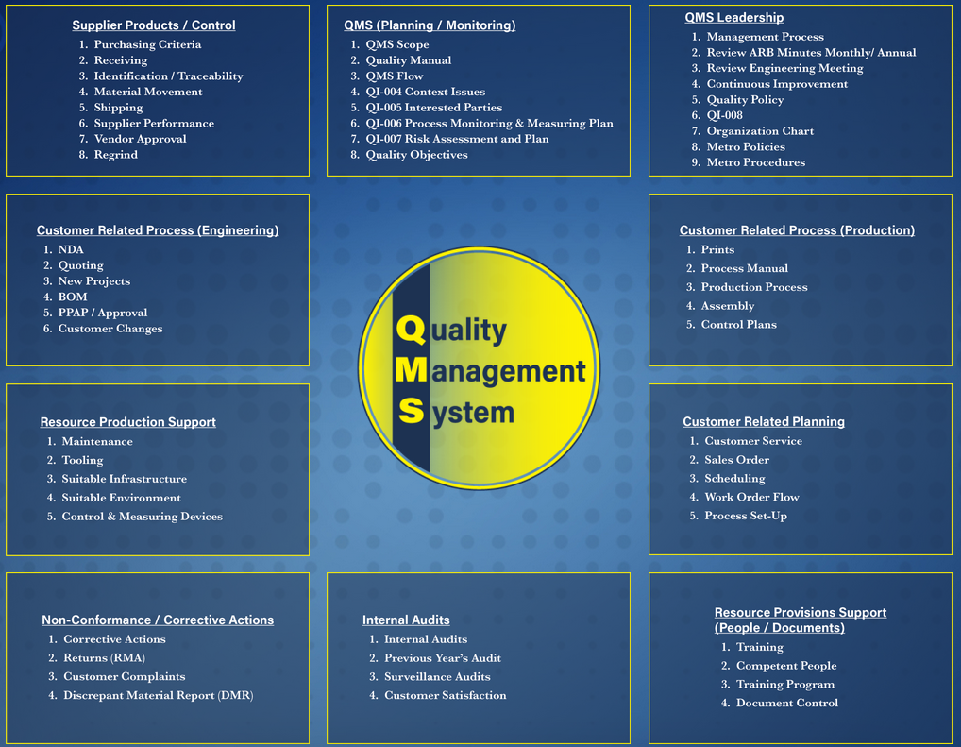
How to access our ISO Documents
https://metroplasticsintranet.wpcomstaging.com/

Slide 4
Course Objectives to execute an Internal Audit
Overview
Procedure Flowchart
Audit Criteria
Prep for an Audit
Opening Meeting
Conduct an Audit
Closing Meeting
Post Audit Activities
Auditor Exam
Notes:
Summarize your research in three to five points.

Slide 5
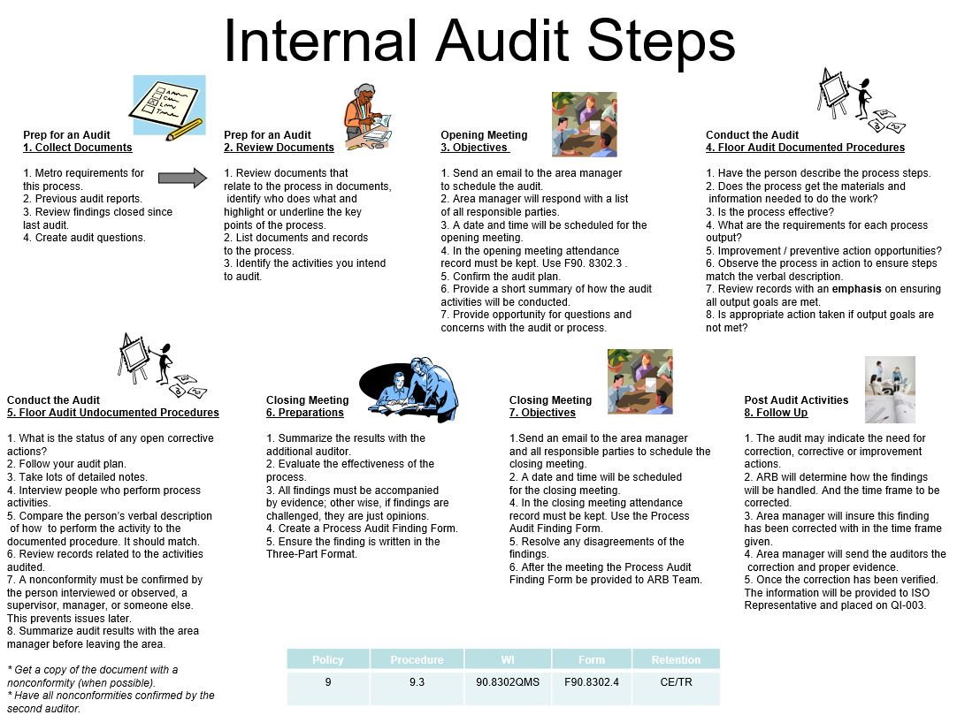
Overview
Internal Audit Status
Internal Audit Status will be given to those who answer all questions correctly on the internal auditor exam.
Student auditors are to be given three attempts to properly answer each inquiry on the exam.
Internal auditors will conduct audits only in areas independent of their direct responsibilities.

Slide 6
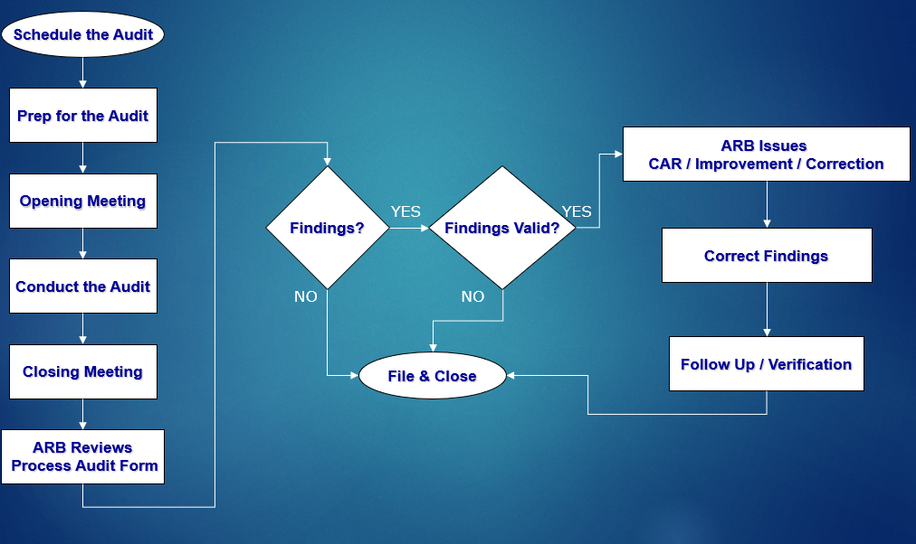
Internal Audit Procedure Flowchart
Notes:
Establish hypothesis before you begin the experiment. This should be your best educated guess based on your research.

Slide 7
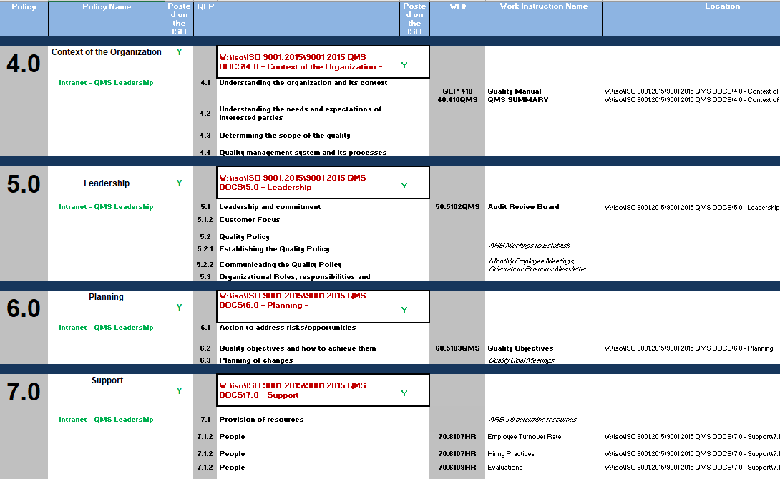
Audit Criteria
Metro Standards
Policies and Procedures
Forms and Logs
Work Instructions
Organizational Chart
Human Resources Information (Not employee personnel files)
Process Flowchart
Notes:
Summarize your research in three to five points.

Slide 8
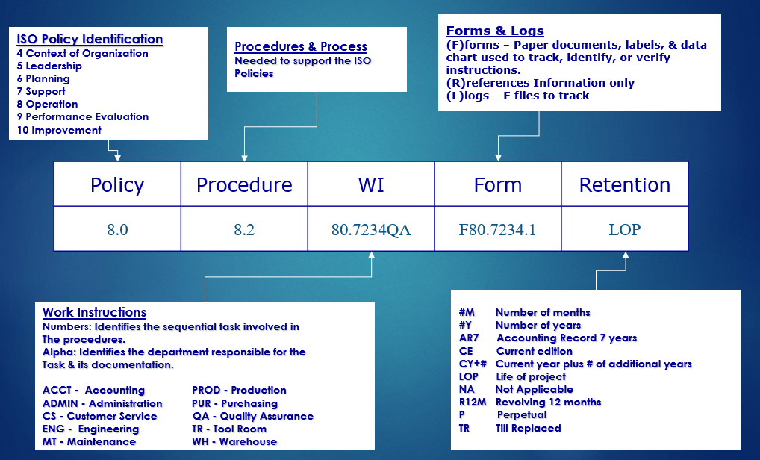
Audit Criteria – Metro Standards (ISO Document Encoding)

Slide 9
Prep for the Audit

Slide 10
Prep for an Audit
Six critical elements of each process
Process owner
Process identified (flowchart, narrative etc..)
Process is defined (input / output)
Linkages are identified, established and understood
Process is monitored, analyzed and improved
  Corrective Action if objective not met
  Continual improvement if objective are being met
Records maintained
Notes:
List all of the steps used in completing your experiment.
Remember to number your steps.

Slide 11
Prep for an Audit
Turtle Diagram Tool
Equipment
Training
Process
INPUT
OUTPUT
Measure
Method
Identify the inputs to be evaluated as part of the audit

Slide 12
Prep for an Audit
Turtle Diagram Example: Making Coffee
Equipment
Machine
Filter
Measuring Cup
Coffee Pot
Training
Competent
Training Records
Make Coffee
INPUT
Beans
Water
Cream
Sugar
Order
OUTPUT
Good Coffee
Measure
Taste
Temp
Customer Satisfaction
Method
Work Instructions
Visual Aid

Slide 13
Prep for an Audit
Strategy
Start with open ended
questions to obtain maximum
information and place the person
at ease
Question Types
Open Ended
Clarifying
Close Ended
Use clarifying questions
to “funnel” down to
the missing
information and
to fill gaps
following the
audit trail
Only use close ended questions to clarify
or obtain specific information

Slide 14
Prep for an Audit
General Information Questions
WHO?
WHY?
WHERE?
HOW?
WHEN?
WHAT?
WHOM?
What Will You Do With The Answer?

Slide 15
Prep for an Audit
Example of Effective Questions
What do you do and what are you responsible for?
Who are your customers (internal)?
What are the product requirements?
Where do you get your information from to direct you?
How do you verify that the product meets requirements?
What feedback do you use that the process is working?

Slide 16
Prep for an Audit
Do’s and Don’ts
Do
Only ask one question at a time
Complete one topic before going to the next
Stay within the scope of the audit
Be a good listener
Talk as though you are having a natural conversation

Slide 17
Prep for an Audit
Do’s and Don’ts
Don’ts
Lose your temper
Argue or get emotional with interviewee
Express your opinion or take sides
Waste time, stay focused
Stick with the FACTS

Slide 18
Opening Meeting
Objectives
The opening meeting must have a record of attendance. Should be held with the affected responsible parties.
Purpose
  Confirm the audit plan
  Provide a short summary of how the audit activities will be conducted
  Provide opportunity for questions

Slide 19
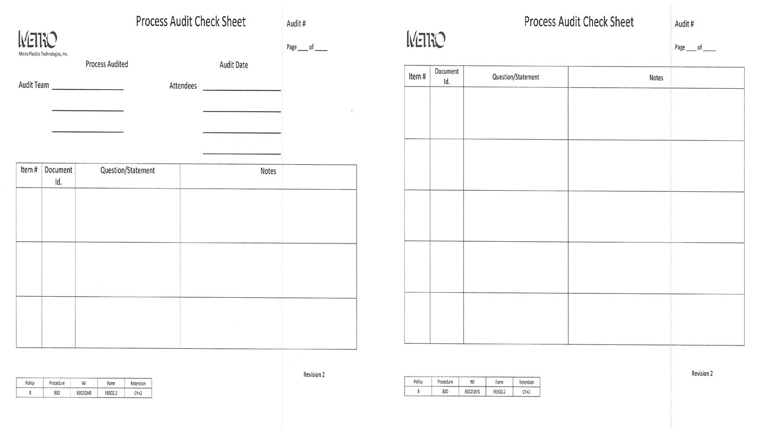
Opening Meeting
Process Audit Check Sheet
Those attending the opening meeting?
Policy | Procedure | WI | Form | Retention
9 | 9.2 | 90.8302QMS | F90.8302.2 | CY+3
Policy | Procedure | WI | Form | Retention
9 | 9.2 | 90.8302QMS | F90.8302.2 | CY+3

Slide 20
Conduct the Audit

Slide 21
Conduct an Audit
Taking Notes
A measure of an effective audit is based on the ability to verify information collected against the criteria
  Requires clarity, accuracy and precision on notes taken by the auditor
Need to Identify
  Exactly what was identified or observed
  The objective evidence in such a manner that the finding could be reproduced so that action can be taken to prevent recurrence

Slide 22
Conduct an Audit
How to Write a Finding
The Three-Part Format
Statement of the Nonconformity – what does it not fulfill
  Monitoring and measuring devices are not effectively controlled
The Requirements – document, work instructions, customer specific
  Work instructions 70.7805QA requires measuring equipment to be calibrated at specific intervals.
Objective Evidence Observed – FACTS, observation, interviews
  Four of the micrometers (sampled six) in the quality lab were either out of calibration (one #4783) or did not have unique identification (three #98761, #98762, #7432).

Slide 23
Closing an Audit

Slide 24
Closing Meeting
Preparations
Prior to the closing meeting the audit team will:
  Evaluate the effectiveness of the process
  Evaluate the evidence against the audit criteria to generate audit findings
  Ensure supporting evidence is verified and recorded for all audit findings

Slide 25
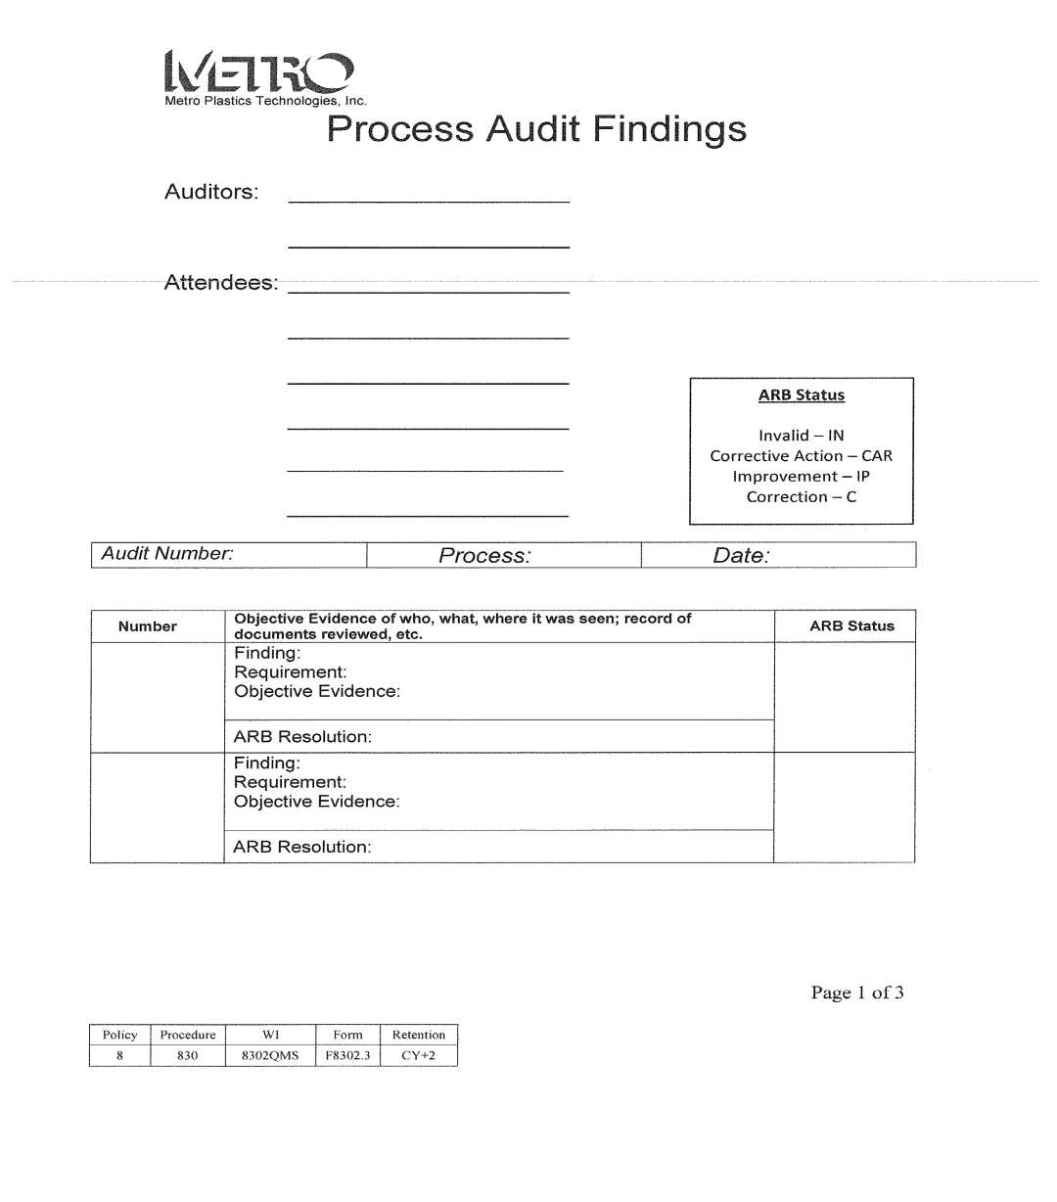
Closing Meeting
Process Audit Finding Form
Policy | Procedure | WI | Form | Retention
9 | 9.2 | 90.8302QMS | F90.8302.3 | CY+3

Slide 26
Closing Meeting
Objectives
The closing meeting must have a record of attendance
Disagreements of the findings should be resolved before the Process
Audit Finding Form is sent to ARB
If the disagreements cannot be resolved, please note on the Process
Audit Finding Form and the ARB will review the non-conformity
Opening Question Form, Process Audit Form and any verification
documents must be placed in an internal audit folder

Slide 27
Post Audit

Slide 28
Post Audit Activities
Follow-Up
The audit conclusion may indicate the need for correction, corrective or improvement actions
  These actions are not part of the audit but are required to be completed
ARB will determine how the findings will be handled
The Operations Manager will ensure these finding’s have been corrected per the ARB conclusion
Verification may be conducted as a follow up audit or proper documentations showing the finding has been corrected
Once the correction has been verified. Date must be entered in the follow up section of the Process Audit Finding Form.

Slide 29
Post Audit Activities
Correction Vs Corrective Action
Correction
  An action to rectify, to make right a wrong
Corrective Action
  Action taken to address a weakness identified in the process
  Normally generated in response to a complaint, abnormal levels of internal nonconformity, or nonconformities identified during an audit

Slide 30

Internal Audit Steps
Prep for an Audit
2. Review Documents
1. Review documents that
relate to the process in documents,
identify who does what and
highlight or underline the key
points of the process.
2. List documents and records
to the process.
3. Identify the activities you intend
to audit.
Opening Meeting
3. Objectives
1. Send an email to the area manager
to schedule the audit.
2. Area manager will respond with a list
of all responsible parties.
3. A date and time will be scheduled for the
opening meeting.
4. In the opening meeting attendance
record must be kept. Use the Process Audit
Check Sheet F8302.2.
5. Confirm the audit plan.
6. Provide a short summary of how the audit
activities will be conducted.
7. Provide opportunity for questions and
concerns with the audit or process.
Conduct the Audit
4. Floor Audit Documented Procedures
1. Have the person describe the process steps.
2. Does the process get the materials and
information needed to do the work?
3. Is the process effective?
4. What are the requirements for each process
output?
5. Improvement / preventive action opportunities?
6. Observe the process in action to ensure steps
match the verbal description.
7. Review records with an emphasis on ensuring
all output goals are met.
8. Is appropriate action taken if output goals are
not met?
Prep for an Audit
1. Collect Documents
1. Metro requirements for
this process.
2. Previous audit reports.
3. Review findings closed since
last audit.
4. Create audit questions.
5. Create audit file folder.
Conduct the Audit
5. Floor Audit Undocumented Procedures
1. What is the status of any open corrective
actions?
2. Follow your audit plan.
3. Take lots of detailed notes.
4. Interview people who perform process
activities.
5. Compare the person’s verbal description
of how to perform the activity to the
documented procedure. It should match.
6. Review records related to the activities
audited.
7. A nonconformity must be confirmed by
the person interviewed or observed, a
supervisor, manager, or someone else.
This prevents issues later.
8. Summarize audit results with the area
manager before leaving the area.
* Get a copy of the document with a
nonconformity (when possible).
* Have all nonconformities confirmed by the
second auditor.
Closing Meeting
6. Preparations
1. Summarize the results with
another auditor.
2. Evaluate the effectiveness of the
process.
3. All findings must be accompanied
by evidence; other wise, if findings are
challenged, they are just opinions.
4. Create a Process Audit Finding Form
F8302.3.
5. Ensure the finding is written in the
Three-Part Format.
Closing Meeting
7. Objectives
1. Send an email to the area manager
and all responsible parties to schedule the
closing meeting.
2. A date and time will be scheduled
for the closing meeting.
4. In the closing meeting attendance
record must be kept. Use the Process
Audit Finding Form F8302.3.
5. After the meeting the Process Audit
Finding Form F8302.3 must be sent to
the ARB for review.
Post Audit Activities
8. Follow Up
1. The audit may indicate the need for
correction, corrective or improvement
actions.
2. ARB will determine how the findings
will be handled. And the time frame to be
corrected.
3. Operations Manager will ensure this finding
has been corrected .
4. Once the correction has been verified.
Date must be entered in the follow up
section of the Process Audit Finding Form
F8302.3.
5. Verify the following forms and documents
are in the audit file folder.
1. Process Audit Check Sheet F8302.2.
2. Process Audit Finding Form F8302.3.
3. Evidence of the correction to the finding.

