Slide 1

Metro Plastics Technologies
Quality management System QMS Flow QI-004C

Slide 2
Quality Management system Flow
Quality Management
System
Audit Review Board

Slide 3
Quality Management system
ISO 9001 / 2015 Requirements
Audit Review Board
Policies
Procedures
Surveillance Audits
Internal Audits

Slide 4
Quality Management system
Policies
Procedures
Work Instructions
Forms, Logs, and Records

Slide 5
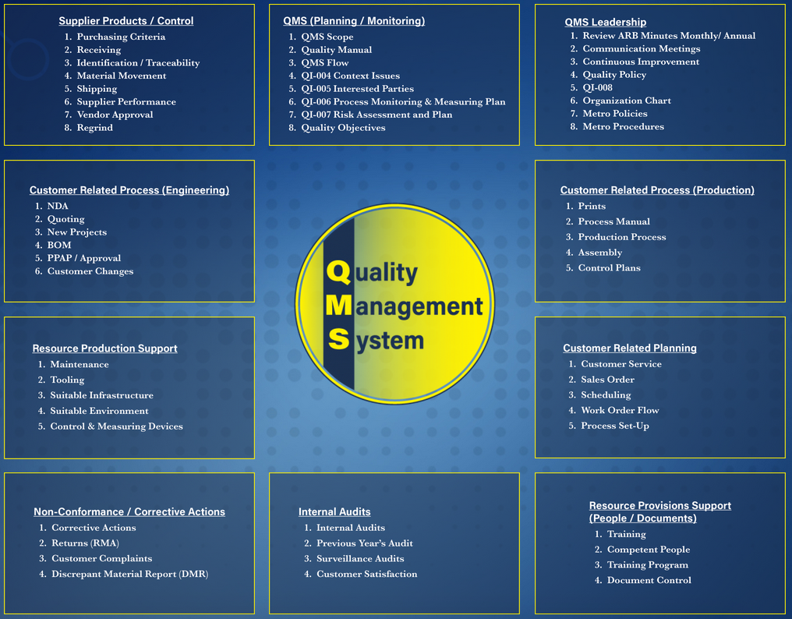

Slide 6
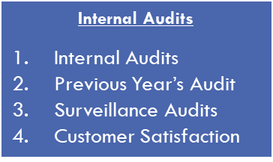
QMS Leadership
Management Process
Review ARB Minutes Monthly/ Annual
Review Engineering Meeting
Continuous Improvement
Quality Policy
QI-008
Organization Chart
Metro Policies
Metro Procedures
Quality Management
System
Production Process
and
Support
QMS (Planning / Monitoring)
QMS Scope
Quality Manual
QMS Flow
QI-004 Context Issues
QI-005 Interested Parties
QI-006 Process Monitoring & Measuring Plan
QI-007 Risk Assessment and Plan
Quality Objectives
Audit Review Board

Slide 7
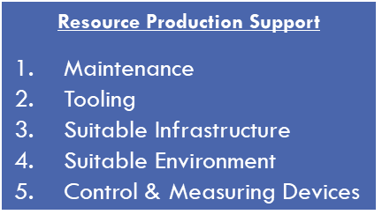
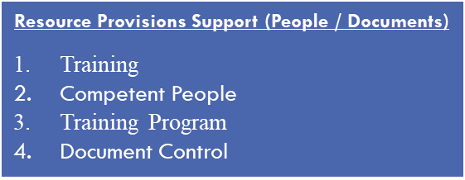
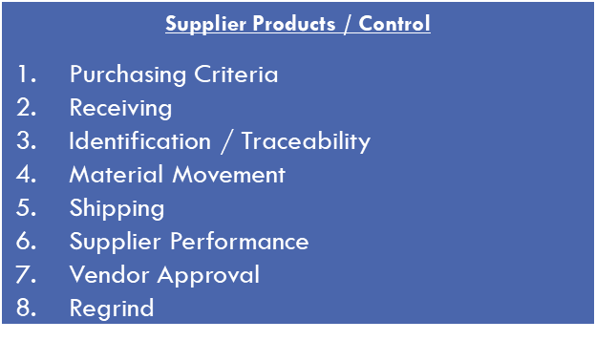
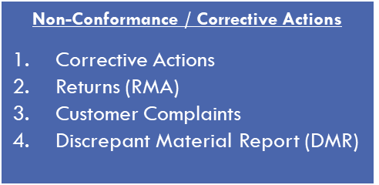
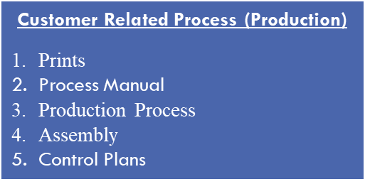
Customer Related Process (Engineering)
NDA
Quoting
New Projects
BOM
PPAP / Approval
Customer Changes
Create / Approve Parts
Customer Related Planning
Customer Service
Sales Order
Scheduling
Work Order Flow
Process Set-Up
Customer Changes
Plan Production
Support
Provide Materials Needed for Production
Ship and Receive Materials and Product
Control of Non-Conformance
Production of Product

Slide 8

Quality Management system
Human Resource Compliance Manager
Maintenance Manager
President
Production Manager
Staff Accountant
Tool Room Manager
Engineering Manager
Purchasing Manager
Quality Manager
VP
Customer Service Manager
Audit Review Board

